Slide 1
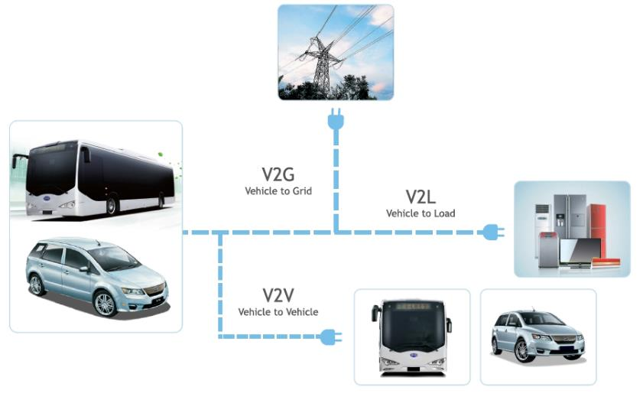
AC Enables V2X; DC Does Not
Discharge AC power back to the grid, to a load or vehicle to vehicle.
Safety Contingency Plan (a single bus is capable of powering a mobile hospital or a Red Cross emergency tent for a week).

Slide 2
Future EV Charge Stations
Private charging companies / AC/DC fast charging partners
EV LEVEL 2
EV LEVEL 3
Private Companies
e.g. ChargePoint
Car Manufacturers
e.g. BYD, Tesla
Energy Sourcing
Companies
220V
AC
480V
DC
480V
AC
Utility Co’s
BYD
V2G
480V
220V
Splitter
z

