Slide 1
Electric Vehicle Technologies: Emerging Opportunities and Challenges
Eva Lerner-Lam, Director and General Manager
Eastern US Business
BYD Motors, Inc.

Slide 2
Challenge: Keeping pace with the Demand for EVs -- Demand for EV charging may outpace growth in the Supply of charging infrastructure -- Slow growth in charging infrastructure Supply may constrain future Demand for EVs
Electric Vehicle Infrastructure
Opportunities: -- Balancing energy between vehicles and grid -- New industry, for example, ChargePoint and SemaConnect
-- VW Settlements
Emerging issue: -- AC as global standard vs. DC as U.S. standard

Slide 3
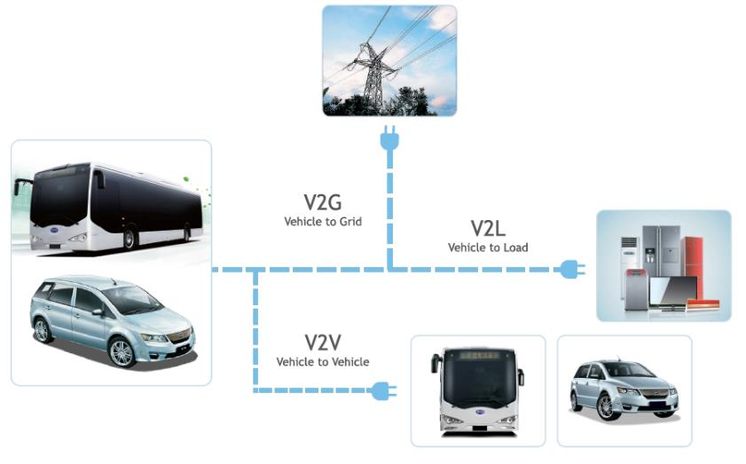
AC Enables V2X; DC Does Not
Discharge AC power back to the grid, to a load or vehicle to vehicle.
Safety Contingency Plan (each bus is capable of powering a mobile hospital or a Red Cross emergency tent for a week).
STRANDED VEHICLE ASSIST

Slide 4
Future EV Charge Stations
Private charging companies / DC fast charging partners / BYD
EV LEVEL 2
EV LEVEL 3
Private Companies
e.g. ChargePoint
Car Manufacturers
e.g. BYD, Tesla
Energy Service
Companies
220V
AC
480V
DC
480V
AC
Utility Co.
BYD
V2G
480V
220V
Splitter

